Slide 1


DAYANANDA SAGAR UNIVERSITY
SCHOOL OF ENGINEERING
Computer Science and Engineering (AIML)
Minor Project Phase-I
MEDIBOOK: A WEB-BASED HOSPITAL APPOINTMENT SCHEDULING SYSTEM
Under the Supervision
Dr./Prof. Pragnya Mishra
Presented By:
Aisha Gilani (ENG24AM0134)
Hithashree H H (ENG24AM0036)
Navami S (ENG24AM0232)
Sunendra (ENG24AM0097)
DAYANANDA SAGAR UNIVERSITY
Notes:
Title of the project
CSE Dept., SET-Jain University

Slide 2
MediBook: A Web-Based Hospital Appointment Scheduling System
Aisha Gilani (ENG24AM0134)
Hithashree H H (ENG24AM0036)
Navami S (ENG24AM0232)
Sunendra (ENG24AM0097)
Project guide: Prof. Pragnya Mishra
Assistant Professor
Dayananda Sagar University
Bengaluru,Harohalli
DAYANANDA SAGAR UNIVERSITY
(#) of 12

Slide 3
Introduction
What is the project?
MediBook is a web-based hospital appointment booking system
It allows patients to book doctor appointments online
Users can select specialty, doctor, and time slot easily
Provides instant confirmation through email notification
Why this project is needed?
Traditional hospital booking is time-consuming
Patients face long waiting queues
Manual scheduling leads to confusion and delays
Lack of proper digital appointment management system
DAYANANDA SAGAR UNIVERSITY
<number> of 12

Slide 4
Literature Review
Paper Title | Journal Name And Year | Technology/ Design | Metrics | Advantages | Limitation
Online Appointment Scheduling System in Healthcare | International Journal of Computer Applications, 2022 | Web-based booking system using frontend-backend architecture | Booking time, user satisfaction | Reduces manual booking effort, improves accessibility | No advanced notification system
Smart Hospital Management System | IEEE Access, 2021 | Full-stack system with database integration | Efficiency, response time | Automates patient management and scheduling | Complex implementation for small hospitals
DAYANANDA SAGAR UNIVERSITY
<number> of 12

Slide 5
Problem Statement
Problem Statement
Visiting hospitals for appointment booking leads to long queues, time loss, and lack of proper scheduling system, causing inconvenience for patients and inefficient hospital management
Proposed Solution (Technology-Based)
Develop a web-based hospital appointment system using React.js, Node.js, Express.js, and MongoDB
Enable users to book appointments online by selecting doctor and time slot
Provide instant email confirmation using Nodemailer
Improve efficiency and reduce manual workload in hospitals
Research Gap
Existing systems lack real-time email confirmation
Many systems are not fully automated end-to-end
Limited user-friendly interfaces in traditional hospital systems
DAYANANDA SAGAR UNIVERSITY
<number> of 12

Slide 6
Aim & Objective
Aim: To develop a web-based hospital appointment booking system(Medibook)
Objective:
To design a user-friendly web interface for appointment booking
To allow users to select speciality, doctor and time slot
To send automatic email confirmation using Nodemailer.
Methodology:
Designing and developing a user-friendly web application with frontend, backend, and database integration to enable appointment booking, doctor/time-slot selection, and automatic email confirmation.
DAYANANDA SAGAR UNIVERSITY
<number> of 12

Slide 7
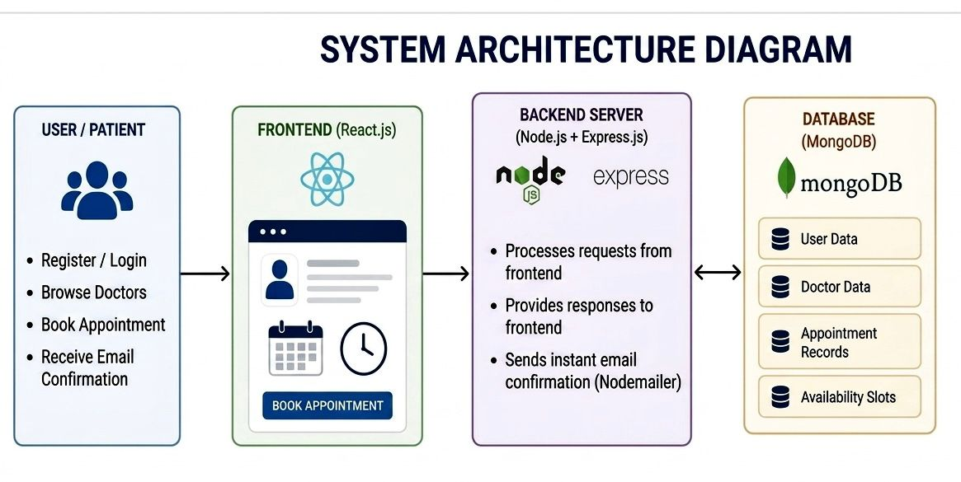
Model Architecture in detail
DAYANANDA SAGAR UNIVERSITY
<number> of 12

Slide 8
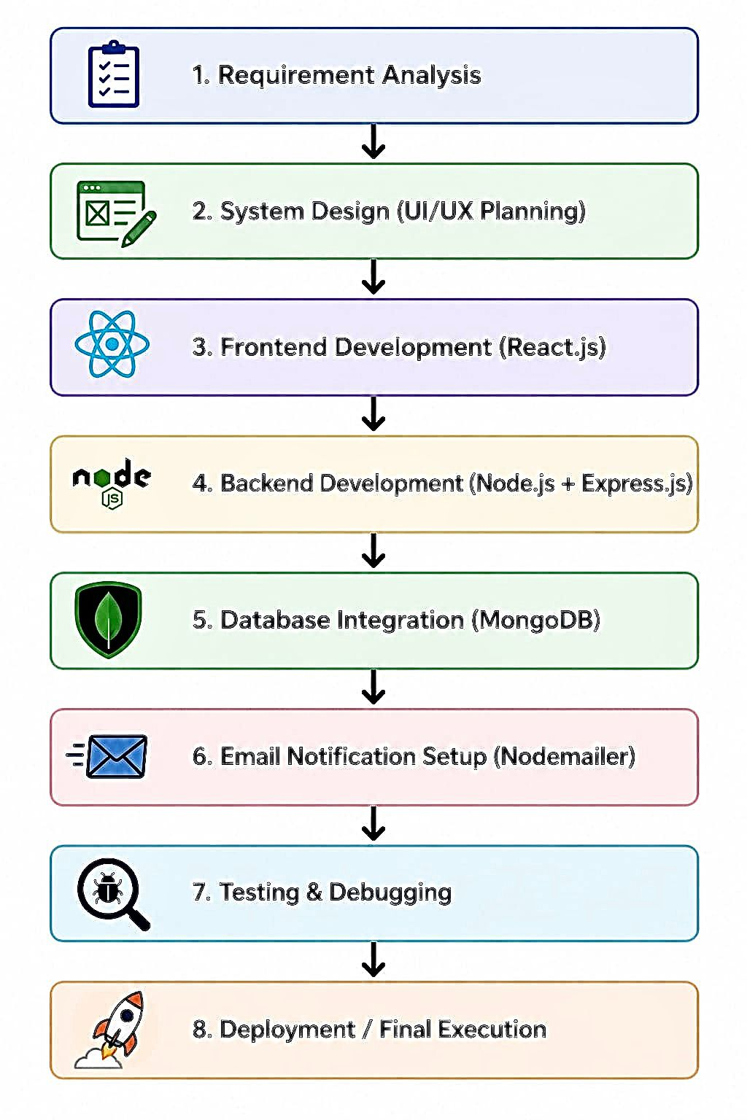
Methodology:
DAYANANDA SAGAR UNIVERSITY
<number> of 12

Slide 9
Results and Discussion:
Successfully developed a web-based hospital appointment system with doctor and time slot selection.
Appointment data is stored in MongoDB and email confirmation is sent automatically to users.
The system improves efficiency by reducing manual booking effort and patient waiting time.
DAYANANDA SAGAR UNIVERSITY
<number> of 12

Slide 10
References
[1] A. K. Sharma, R. Gupta, “Online Hospital Appointment Scheduling System Using Web Technologies”, International Journal of Computer Applications, 2022.
[2] P. Singh, M. Verma, “Smart Healthcare Management System Using Full Stack Development”, IEEE Access, 2021.
[3] S. R. Nair, “Web-Based Patient Appointment System for Hospitals”, Journal of Health Informatics, 2020.
DAYANANDA SAGAR UNIVERSITY
<number> of 12

